Slide 1
Sesson 3
Data visualization using Matplotlib and Seaborn

Slide 2
Agenda
What Is Data Visualization
Matplotlib & Seaborn
Distribution Plots
Categorical Plots
Matrix Plots

Slide 3
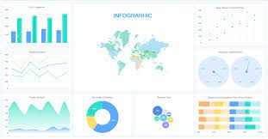
What is Data Visualization
Data visualization is the graphical representation of information and data. By using visual elements like charts, graphs, and maps, data visualization tools provide an accessible way to see and understand trends, outliers, and patterns in data.
Our eyes are drawn to colors and patterns. We can quickly identify red from blue, square from circle. Our culture is visual, including everything from art and advertisements to TV and movies.
Data visualization is another form of visual art that grabs our interest and keeps our eyes on the message

Slide 4
Matplotlib & Seaborn
Seaborn and Matplotlib are two of Python's most powerful visualization libraries. Seaborn is built on top of matplotlib so it’s more like a wrapper, Seaborn uses fewer syntax and has stunning default themes and Matplotlib is more easily customizable through accessing the classes.

Slide 5


Matplotlib & Seaborn
Install and use
Install
Use

Slide 6
Distribution Plots
Distributon Plots:
Univariant Plots:
1) distplot
2) kdeplot
Bivariant Plots:
1)pairplot

Slide 7
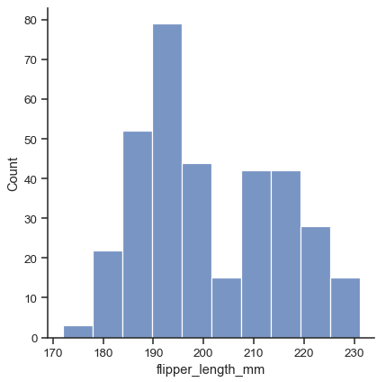
Distribution Plots
Distributon Plots:
Univariant Plots:
1) distplot
2) kdeplot
Bivariant Plots:
1)pairplot

Slide 8
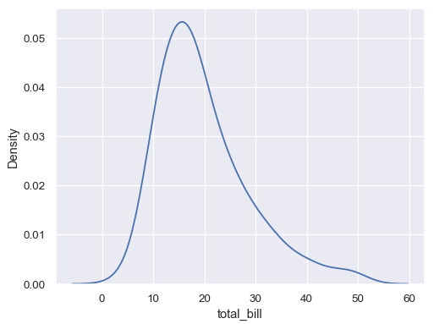

Distribution Plots
Distributon Plots:
Univariant Plots:
1) distplot
2) kdeplot
Bivariant Plots:
1)pairplot

Slide 9
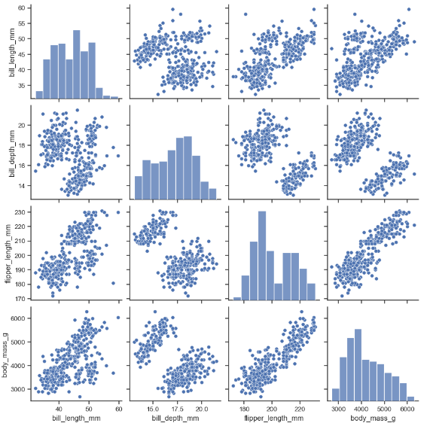
Distribution Plots
Distributon Plots:
Univariant Plots:
1) distplot
2) kdeplot
Bivariant Plots:
1)pairplot

Slide 10
Categotrical Plots
Categorical Plots:
Categorical Distribution Plots:
boxplot
violinplot
categorical Scatter Plots:
swarmplot
Categorical Estimate Plots:
countplot

Slide 11
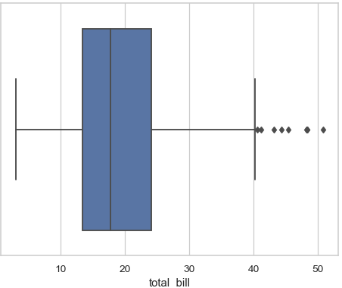

Categotrical Plots
Categorical Plots:
Categorical Distribution Plots:
boxplot
violinplot
categorical Scatter Plots:
swarmplot
Categorical Estimate Plots:
countplot

Slide 12
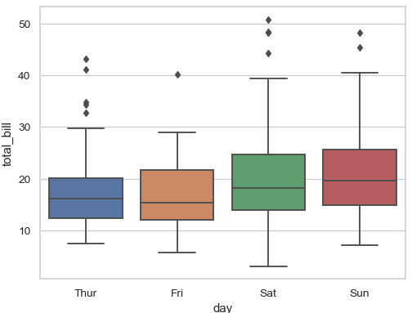

Categotrical Plots
Categorical Plots:
Categorical Distribution Plots:
boxplot
violinplot
categorical Scatter Plots:
swarmplot
Categorical Estimate Plots:
countplot

Slide 13
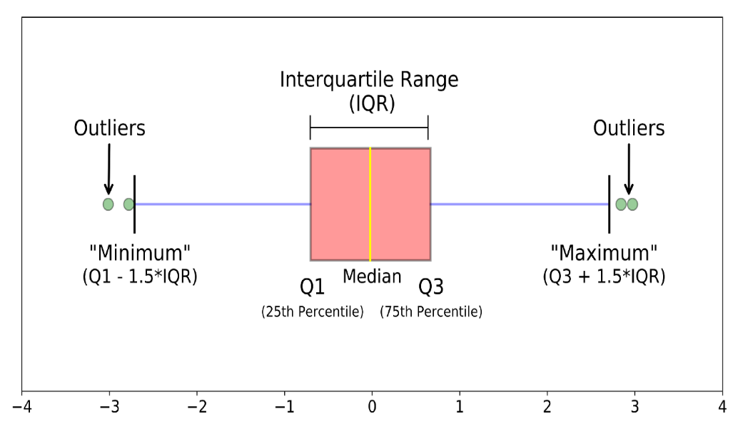
Categotrical Plots
What is boxplot?
A boxplot is a standardized way of displaying the distribution of data based on a five number summary (“minimum”, first quartile (Q1), median, third quartile (Q3), and “maximum”).
It can tell you about your outliers and what their values are. It can also tell you if your data is symmetrical, how tightly your data is grouped, and if and how your data is skewed.

Slide 14
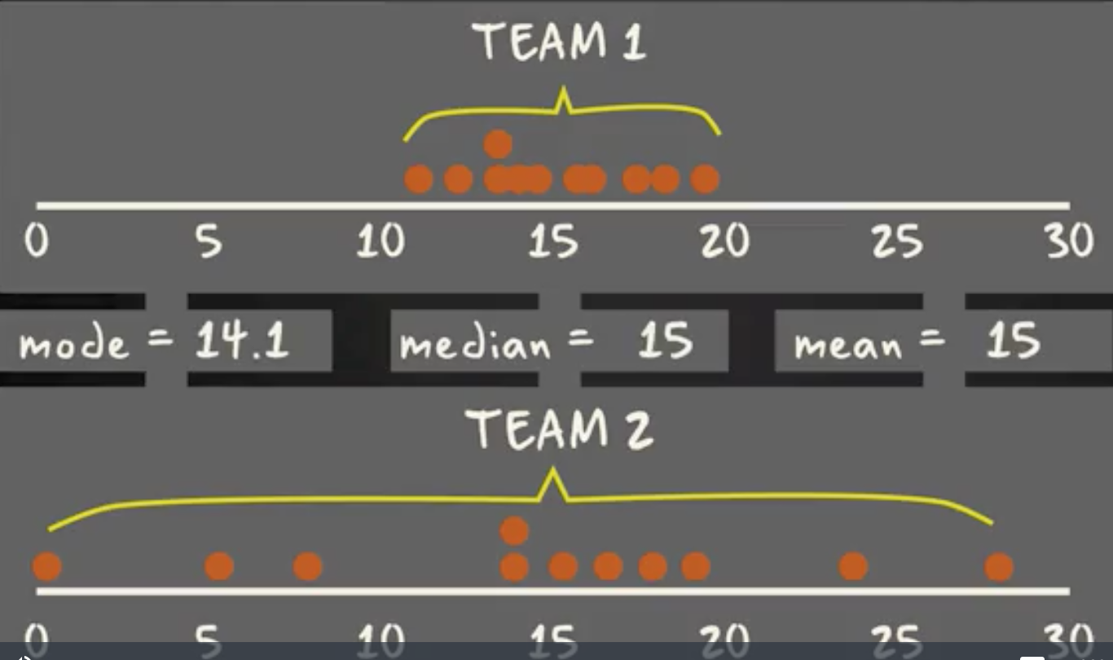
Categotrical Plots
Same mode, mean and median
But different distribution

Slide 15
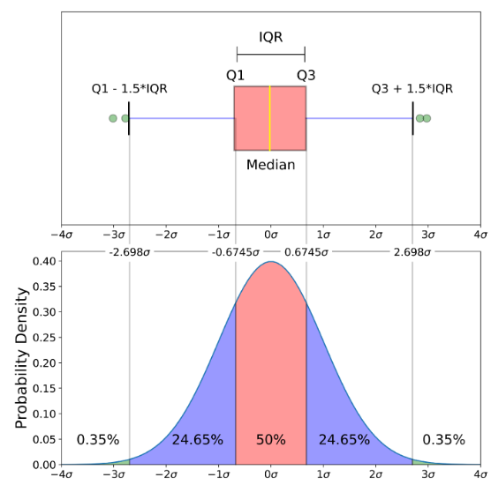
Categotrical Plots

Slide 16
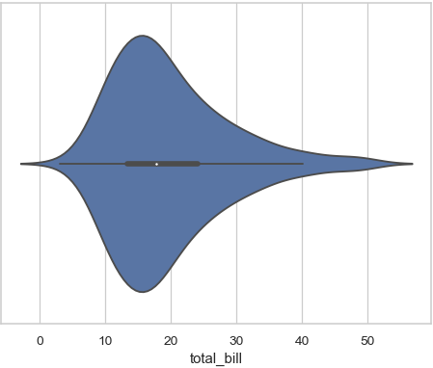
Categotrical Plots
Categorical Plots:
Categorical Distribution Plots:
boxplot
violinplot
categorical Scatter Plots:
swarmplot
Categorical Estimate Plots:
countplot

Slide 17
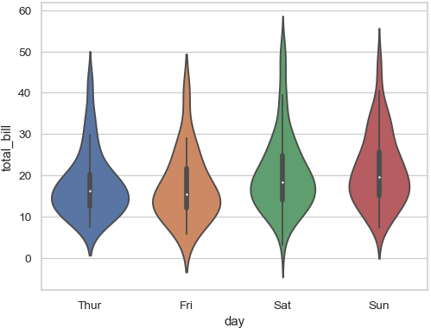

Categotrical Plots
Categorical Plots:
Categorical Distribution Plots:
boxplot
violinplot
categorical Scatter Plots:
swarmplot
Categorical Estimate Plots:
countplot

Slide 18
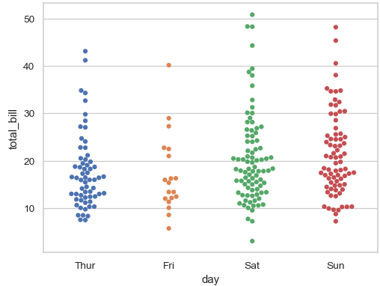

Categotrical Plots
Categorical Plots:
Categorical Distribution Plots:
boxplot
violinplot
categorical Scatter Plots:
swarmplot
Categorical Estimate Plots:
countplot

Slide 19
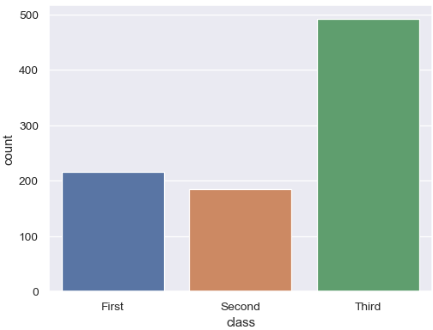

Categotrical Plots
Categorical Plots:
Categorical Distribution Plots:
boxplot
violinplot
categorical Scatter Plots:
swarmplot
Categorical Estimate Plots:
countplot

Slide 20
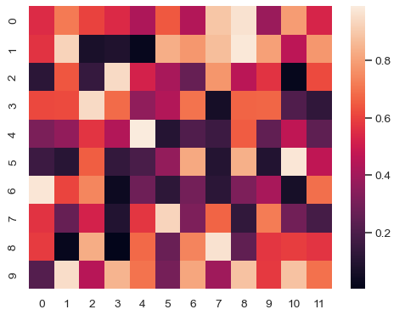
Matrix Plots
Matrix Plots:
Heat map

